Slide 1
Taxation of Business Profits
and
Corporate Income Tax
Tax Policy Course
Sebastian James
World Bank

Slide 2
Corporate Income Tax
Corporations and their taxation are treated as legal entities or legal persons separate from their owners.
Why are Corporations taxed as they are not living persons?
Issues of integration of corporate with personal income tax for resident owners and harmonization of tax with foreign jurisdiction for owners of non-resident corporations become relevant
The taxation of income from Corporations is fundamentally no different from the taxation of any other kind of business income
  Even individuals could earn business Income and would be taxed just like corporations except that corporations could have an additional step that they distribute their post taxed income to their shareholders as dividend
  Further Corporations don’t earn employment Income

Slide 3
Business Income
Definition of business income: Using the same definition as personal income from the uses side of income:
Income = Consumption + Change in net worth
Consumption = payment of dividends (in the case of corporations)
Change in net worth = retained earnings + capital gains/losses on assets and liabilities.
However post taxed incomes of Corporation when distributed to shareholders as dividend are taxed again in the hands of the receiver
Retained earnings are post taxed incomes that are not distributed to shareholders but retained for future investments.
Value of the Corporation (market value of all its shares) should be equal to the present value of all future incomes that it generates (including assets it owns when sold on liquidation)

Slide 4
BUSINESS INCOME AS VIEWED BY AN ACCOUNTANT

Slide 5
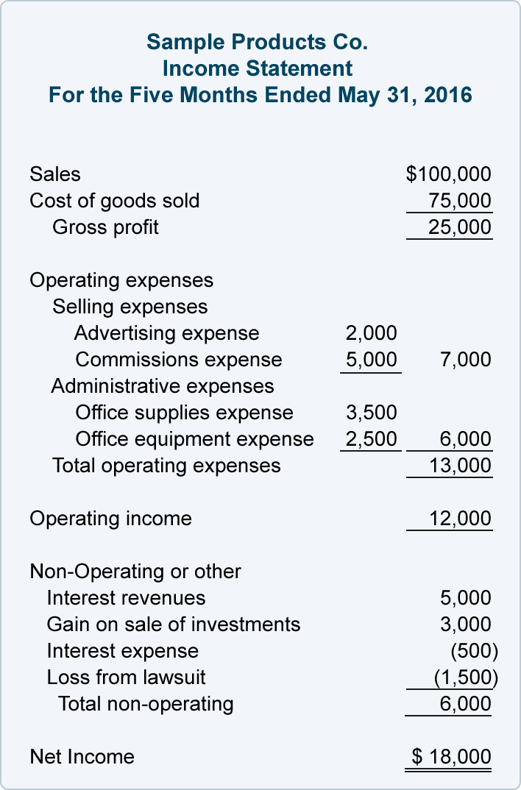
Income Statement Example
Source: Accounting Coach.com

Slide 6
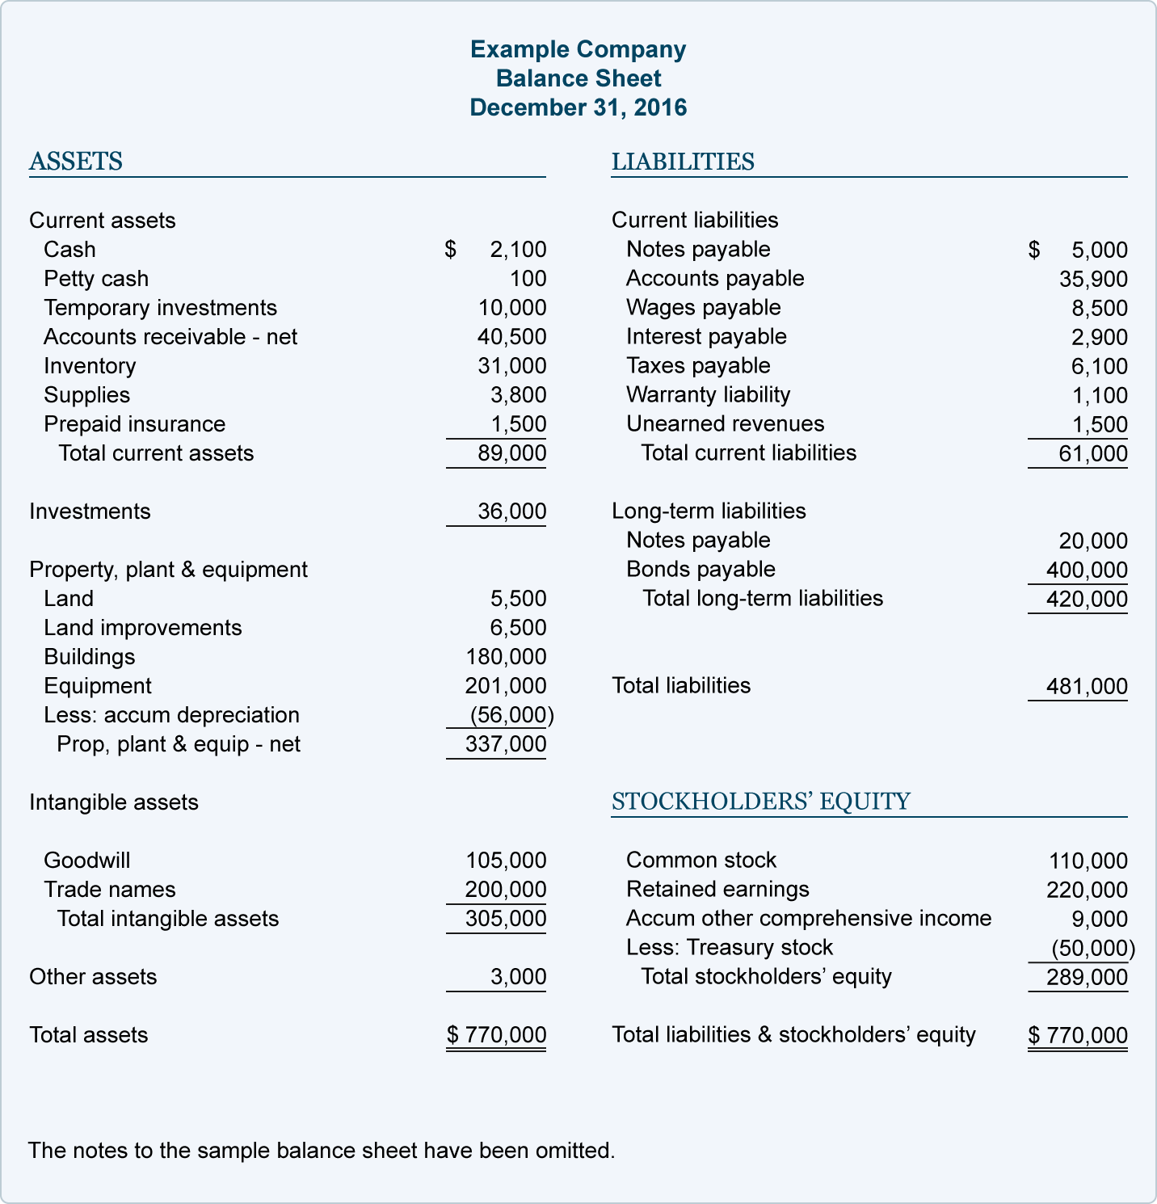
Balance Sheet Example
Source: Accounting Coach.com
Notes:
What is 'Accumulated Other Comprehensive Income'
Accumulated other comprehensive income (OCI) is a line item in the shareholders' equity section of the balance sheet that includes income that is not reported in the income statement. Other comprehensive income includes unrealized gains and losses on certain types of investments, as well as gains or losses on pension funds and foreign currency transactions.
Read more: Accumulated Other Comprehensive Income Definition | Investopedia http://www.investopedia.com/terms/a/accumulatedother.asp#ixzz4ceMRAmOe
Treasury stock is a company's own stock that it has reacquired from shareholders. When a company buys back shares, the expenditure to repurchase the stock is recorded in a contra equity account. This is a balance sheet account that has a natural debit balance.

Slide 7
BUSINESS INCOME AS VIEWED BY AN ECONOMIST

Slide 8
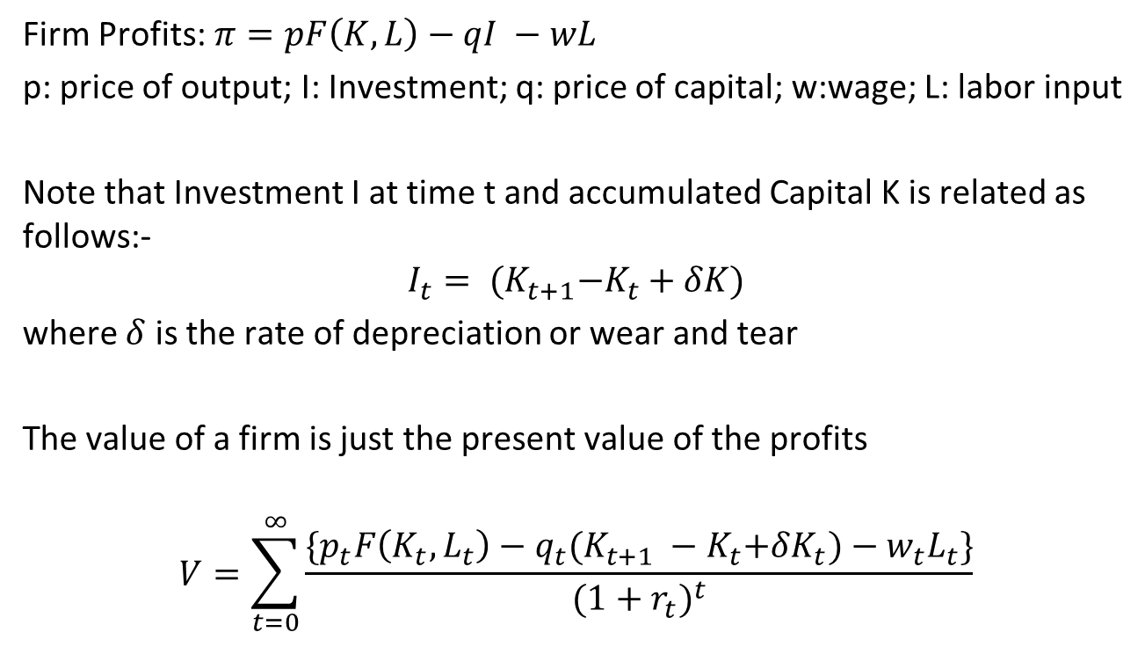
Taxation of the Firm

Slide 9
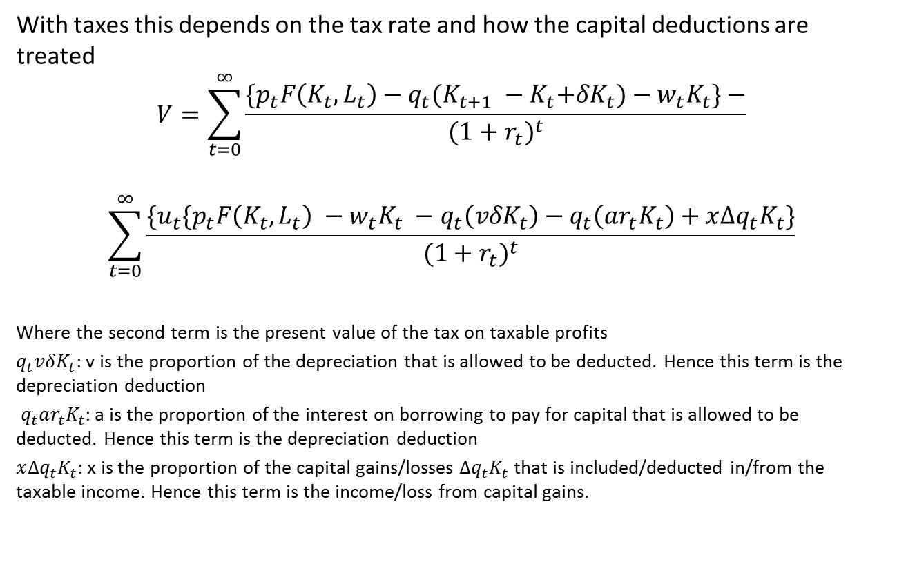
Taxation of the Firm

Slide 10
BUSINESS INCOME AS VIEWED BY A LAWYER

Slide 11
Profits and gains of business or profession
28. The following income shall be chargeable to income-tax under the head “Profits and gains of business or profession”,—
(i) the profits and gains of any business or profession which was carried on by the assessee at any time during the previous year;
(ii) any compensation or other payment due to or received by,—
(a) any person, by whatever name called, managing the whole or substantially the whole of the affairs of an Indian company, at or in connection with the termination of his management or the modification of the terms and conditions relating thereto;
(b) any person, by whatever name called, managing the whole or substantially the whole of the affairs in India of any other company, at or in connection with the termination of his office or the modification of the terms and conditions relating thereto;
(c) any person, by whatever name called, holding an agency in India for any part of the activities relating to the business of any other person, at or in connection with the termination of the agency or the modification of the terms and conditions relating thereto;
(iii) income derived by a trade, professional or similar association from specific services performed for its members.
¹[(iv) the value of any benefit or perquisite, whether convertible into money or not, arising from business or the exercise of a profession.]
Explanation 1.—The profits and gains of a business shall include the profits and gains of managing agency.
Explanation 2.—Where speculative transactions carried on by an assessee are of such a nature as to constitute a business, the business (hereinafter referred to as “speculation business”) shall be deemed to be distinct and separate from any other business.
29. Income from profits and gains of business or profession, how computed.- The income referred to in section 28 shall be computed in accordance with the provisions contained in sections 30 to 43D.

Slide 12
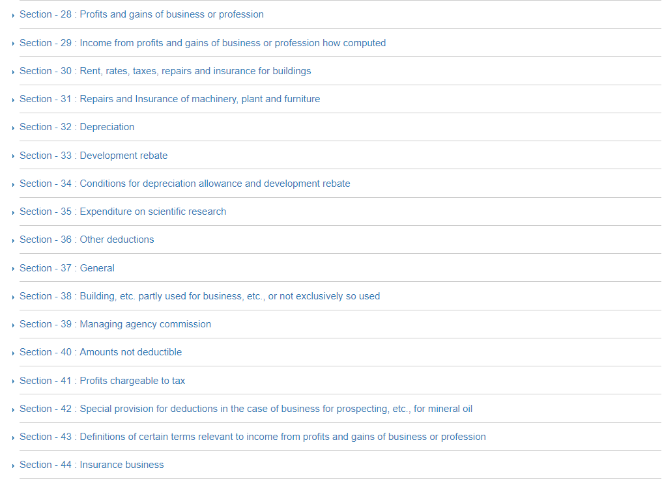

Slide 13
Business Income
In practice: Business Income is defined from the sources side in terms of revenues earned less the costs of earning income plus capital gains. Tax base or taxable income:
Generally, Taxable income = Sales revenue - cost of goods sold - depreciation allowances - financing costs - overheads.
Receipts from sales are “Revenue Receipts” which are recurring by nature (received again and again) and which are available for meeting all day to day expenses (revenue expenditure). Apart from sale proceeds of goods, revenue receipts also include receipt of interest payment, commission and rent received etc.; shown on credit side in profit loss account.
Receipts of non-recurring nature whose benefit is enjoyed over a long period are called "Capital Receipts", e.g. money brought into the business by the owner (capital invested), loan from bank, sale proceeds of fixed assets etc. Capital receipt is shown on the liabilities side of the Balance Sheet.

Slide 14
Various Accounting Practices
Financial or commercial accountancy is governed by both local and international accounting standards. Generally accepted accounting principles (GAAP) is the standard framework of guidelines for financial accounting used in any given jurisdiction. It includes the standards, conventions and rules that accountants follow in recording and summarizing and in the preparation of financial statements.
International Financial Reporting Standards (IFRS), on the other hand, is a set of accounting standards stating how particular types of transactions should be reported in financial statements. IFRS are issued by the International Accounting Standards Board (IASB). With IFRS becoming widespread, consistency in financial reporting has improved between global organizations.
Tax accounting rules are often different from the general financial accounting principles for a variety of reasons.

Slide 15
Tax Accounting for Business Income Taxation (1)
The simplest approach is to use the income that is obtained by using the standard Accounting principles.
However tax laws in most cases use different rules to obtain taxable income
This usually is derived by starting from accounting Income and adding back those incomes that are considered taxable (and not included in the income side as per accounting principles) and removing those expenses that are not allowed by the tax law (but allowed by the accounting principles)
Examples of expenses not permitted for deduction from income:-
  provision of bad debts and other taxes, fines and penalties; certain expenditures which government may like to discourage such as entertainment expenses or which are not incurred “wholly and exclusively” for business purposes.

Slide 16
Tax Accounting for Business Income Taxation (2)
Income tax laws and accounting also usually restrict the valuation conventions that may be employed in measuring income (discussed later)
The main purpose of these specific provisions in income tax law is to make the measure of income for tax purposes more objective than it may be in commercial accounts that are meant to serve other purposes.
Similarly, income tax laws must provide for specific deductions not necessarily in commercial accountings of business such as any deduction for losses brought forward from earlier years.

Slide 17
Tax Rates and Their Declining Trend
Corporate income tax (CIT) rate typically set at rate at or less than top MTR under PIT
Global investment competition has been driving down CIT rates over past three decades by about 20 percentage points to rates at or below 30% in most countries.
Many countries now have lower CIT rate on corporate earnings (first layer tax) and charge a secondary tax or final withholding tax on distributed dividends (secondary tax).
Secondary (ST) or withholding tax is also important to ensure that corporate dividends are ultimately taxed at same rate as top PIT MTR. For example if CIT rate =25% and top PIT MTR =40%, then ST = (40%-25%)/(1-25%) = 20% closes the gap between the top PIT MTR and CIT rate on dividends distributed to individuals.

Slide 18
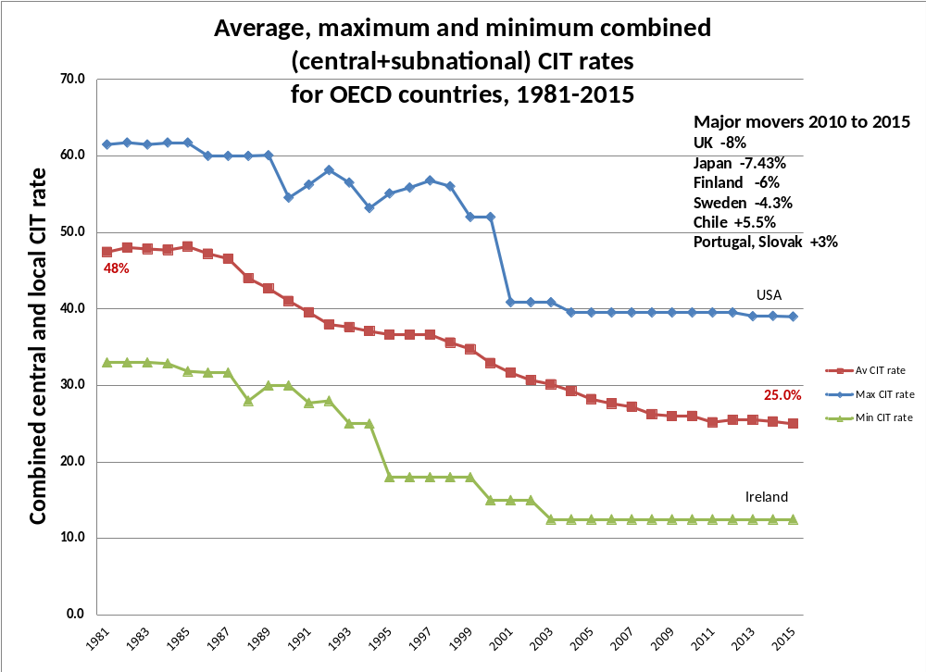
Average statutory rates in Asean countries dropped from 35% in 1985 to 28% in 2005
Plus “Tax havens” – no tax, but no production; and special treaty treatments

Slide 19
Inventory valuation or Cost of goods sold
(a) Issue of inventory valuation becomes relevant if prices are changing with time (real or inflationary), method of calculating COGS needs to be specific and well defined in order to define costs of items withdrawn from inventory used in making sale.
(b) Three methods normally applied:
- First In First Out or FIFO method: the oldest inventories taken as the COGS.
- Last In First Out or LIFO method: the cost of raw materials purchased last is the COGS.
- Mixture of the two: average of oldest and new inventory costs
  Choice of inventory valuation affects tax liability – highest in FIFO, lowest in LIFO and in-between in average.
  Most tax laws allow choice of valuation method but exclude LIFO which defers tax payment; Taxes deferred are taxes saved.
  Illustrations: Assume price increase of 10% each period and a corporate tax of 40%.

Slide 20
COGS (FIFO)
FIFO
Years 1 2 3 4
Sales 200 220 242
Purchases 100 110 121
COGS 100 110 121
Taxable Income 100 110 121
Tax liability (nominal) 40 44 48.4
Tax liability (real) 36.36 36.36 36.36
PV of tax
(@ 8% discount rate) 33.67 31.18 28.87
PV of total tax liability 93.72

Slide 21
COGS (LIFO)
LIFO
Sales 200 220 242
Purchases 100 110 121
COGS 110 121 100
Taxable Income 90 99 142
Tax liability (nominal) 36 39.6 56.8
Tax liability (real) 32.73 32.73 42.67
PV of tax
(@ 8% discount rate) 30.31 28.06 33.87
PV of total tax liability 92.24
(normally even lower if inventory liquidation deferred for longer)

Slide 22
Depreciation allowance
Depreciation (Capital Consumption) Allowance:
Reflects the wear and tear of capital (plant, machinery, building) during production process and is therefore a cost of earning income.
• Ideally, should use economic depreciation or actual wear and tear or decline in income earning capacity of an asset. Difficult to determine, especially as company uses a large number of machines and equipment.
Following four methods are available:
(i) Straight line depreciation
(ii) Declining balance
(iii) Immediate expensing
Depreciation on historical cost of assets and not on values adjusted to current prices that could have capital appreciation

Slide 23
Depreciation methods (1)
(i) Straight line method: Based on the historical cost of the machine, life of the asset, and the estimated salvage value at the end of life, a uniform rate of depreciation calculated.
C = historical cost
SV = Salvage value (often assumed to be zero)
n = life of asset (standard tables for different machinery/ equipment usually available in tax laws)
D = annual depreciation = (C - SV) / n
• Requires asset-by-asset depreciation accounts
• Often used for large long-lived assets such as buildings

Slide 24
Depreciation methods (2)
(ii) Declining balance: Provides an allowance equal to constant proportion of outstanding undepreciated balance of assets.
C = historical cost;
d = depreciation rate;
Annual depreciation allowance = C*d, in first year,
= C*(1-d)*d in second year,
= C*(1-d)²*d, in third year etc.
• For economic life of asset of n years, set d=2/n (double declining balance method). Studies show economic depreciation closely follows declining balance
• Can allow pooling of all assets in same depreciation rate class rather than asset by asset depreciation accounts. New purchases in asset class added to pool, sales of assets subtracted from pool. Depreciation rate for class of assets applied to pool. Simplification makes pooled declining balance popular tax reform measure.

Slide 25
Depreciation methods (3)
(iii) Immediate expensing: The whole capital cost depreciated in the first year. Equivalent to declining balance with d = 100%. Form of accelerated depreciation used as important investment incentive
Actual practices vary: Straight line used by Italy, Portugal and Greece; declining balance by Japan, Switzerland and Spain; UK allows 50% expensing for building & Machines while Ireland allows immediate expensing for both; some countries switch from declining to straight line after a few years; USA has a complex method where rate may vary from year to year.
Illustrations of the four methods:
Taxable income before depreciation $100, and cost of asset purchased in year 1 for $90 (historical cost) with 3 years of life.

Slide 26
Straight line method
        Years 1 2 3
(i) Straight line method
Taxable income before
depreciation allowance 100 100 100
Depreciation 30 30 30
Taxable income 70 70 70
Tax liability 28 28 28
PV of tax 25.5 23.1 21.0
(@ 10% discount rate)
PV of total tax liability 69.64

Slide 27
Declining balance
(ii) Declining balance method
Taxable income before
depreciation allowance 100 100 100
Depreciation (d=2/3) 60 20 6.7
Taxable income 40 80 93.3
Tax liability 16 32 37.3
PV of tax (@ 10% discount) 14.5 26.4 28.0
PV of total tax liability 69.0

Slide 28
Immediate expensing
(iii) Immediate expensing method
Taxable income before
depreciation allowance 100 100 100
Depreciation 90
Taxable income 10 100 100
Tax liability 4 40 40
PV of tax 3.64 33.1 30.0
(@ 10% discount rate)
PV of total tax liability 66.75

Slide 29
Comparison of methods
• Total deduction is the same in each cases (except declining balance requires more than 3 years to get full deduction), but the difference is in timing.
• The present value of taxes paid from lowest to highest
i. immediate expensing
    ii. declining balance
    iii. straight line method
• Depreciation based on the historical cost of capital and not on the replacement cost of asset. Value of asset generally not adjusted for changes in price in subsequent years. Important to distinguish between capital/gains losses and depreciation.

Slide 30
Financing costs and Thin Capitalization
A Corporation could be financed by Equity or by both Equity and Debt
However generally debt is allowed as an expense while not equity
With a higher debt, tax liability of corporation lower. It creates a bias towards debt financing rather than equity. Excessive debt leads to thin capitalization and that may cause bankruptcy.
  So some countries mandate a maximum debt-equity ratio.
Illustration
For a corporation with 100% equity financing of $200, three years of life and a corporate tax rate of 50%, tax liability is as follows:

Slide 31
Financing costs (2)
100 % equity
Years 1 2 3
Taxable income 50 50 50
Tax liability 25 25 25
PV of tax 23.1 21.4 19.8
(@ 8% discount rate)
PV of total tax liability 64.42

Slide 32
Financing costs (3)
Alternatively, with a 50% loan of 100 at 10%
50 % equity and 50% debt
Taxable income 50 50 50
Interest expense (10%) 10 10 10
Taxable income 40 40 40
Tax liability 20 20 20
PV of tax 18.51 17.15 15.88
(@ 8% discount rate)
PV of total tax liability 51.53

Slide 33
Overheads
    Overheads:
Expenses on general administration (legal, accounting, etc.), advertising, public relations or business promotion activities not directly attributable to specific sales
• A deduction not justified as a cost of doing business is a subsidy given by society to a taxpayer. A great deal of care to be exercised in scrutinizing deductible items.

Slide 34
Treatment of losses
• Ideally, income and losses should be treated symmetrically: tax compensation for losses. Particularly important for risky projects.
• If symmetrical treatment of income and losses, then taxation leaves expected net-of-tax return unchanged (but still lower than without tax). Effectively government shares risk with investor.
• If government taxes income, but under compensates losses, then expected net-of-tax return declines (relative to symmetrical case).
In practice, profit and capital gain taxes tend to take higher share of gains than share of losses.

Slide 35
Mechanisms for loss offsets
• Loss off-set, through reduction of taxable income of a company in its profit making activities by an amount equivalent to losses in a risky project in the same year.
Also consolidation of tax accounts across companies, otherwise companies merge to realize tax losses. Problem for start-up companies – delayed loss realization.
• Alternatively, the loss incurred allowed to be off-set against its profits in an earlier or later period through loss carry backwards or loss carry forward. Often a trade off between allowing consolidation and length of loss carry forwards – where no consolidation, loss carry forwards sometimes indefinite.
Loss carry forward/backward provisions are a form of income averaging across time.
Full loss carryforward/back reflects a life cycle view of business rather than a year-to-year snapshot

Slide 36
International tax harmonization
Multi-national corporations (MNCs) that operate in more than one country, have a country where headquarters or owners are located/registered (“home country”) and country of business (“host country”).
• MNC could either open a subsidiary or a branch in host country. A subsidiary, incorporated in the host country, has independent legal existence, usually wholly owned by the parent company and pays dividends to its shareholders in the home country.
• A branch is unincorporated, more like a field office, and returns profits to the parent company without declaring dividends. Branch accounts are part of parent company consolidated accounts.
Issue of identifying “permanent establishments” of a business in a host country is difficult for some services and especially for e-services or internet delivered services.

Slide 37
Home and Host Country Issues
• In case of subsidiary, host country can tax the profits of the resident company as well as dividends distributed to the resident and non-resident shareholders by imposing a withholding tax.
• In case of a branch, host country can only tax profits. To capture the same amount of revenue from the two alternatives, rate of tax often set higher for a branch than subsidiary.
Avoiding double taxation of income: To avoid double taxation in such cases, the home country may often give a foreign tax credit (FTC) for taxes paid in the host country. Typically, credit is lower of taxes paid in host country or taxes payable in home country.
Some countries only offer FTC where Tax Treaties; others offer it as a general principle.

Slide 38
Related parties and transfer pricing
Loss of tax through shifting income (or tax base) between two related (non-arms length) parties with different tax rates by
  transferring income or revenue to low tax rate party and/or
  transferring deductions or costs to high tax rate party
Examples:
Domestic tax problems
  Domestic parent company and domestic branch or subsidiary in a tax free zone (“domestic tax haven”) or qualifying for major income tax incentive or different state/province with different tax rate
  International tax problem
  Parent company with a branch or subsidiary in a host country with a significantly different CIT rate

Slide 39
Mechanisms for shifting income
Transfer of tangibles or trade in goods at non-arms-length price
Transfer of intangibles
  Excess royalties for right to use industrial and artistic rights (patents, trademarks, designs, etc.)
Intra-group services
  management, marketing, technical advice, accounting, etc. at non-arms length prices
Intra-group debt
  Excess debt (thin capitalization) and/or debt supplied at above market interest rates
Intra-group real property rental (uncommon)

Slide 40
Transfer Pricing Issues
Taxable income of a subsidiary/ branch:
Sales - COGS - depreciation – interest payments - overheads.
Major valuation problem with related parties.
(a) Cost of goods sold:
• Host country needs to ensure that the prices used by the company to calculate the COGS, are not artificially set to transfer profits from high- to low-tax rate country. The subsidiary may be purchasing inputs/ raw materials from or selling final product to parent company at prices that do not reflect market prices.
• The tax authority of the host country must compare the prices with "arm's length prices". Services of specialized agencies may be utilized e.g. SGS (Societe General de Surveillance). Similar to Customs valuation problem.

Slide 41
Transfer pricing issues (contd.)
(b) Overheads:
• Subsidiary may be utilizing services of consultants at very high fees, or receiving product samples at very high prices, or paying unusually high management fees or paying high royalties for use of patents to the parent company.
Limits on deductions for branches and/or withholding taxes on payments to non-residents are common.
(c) Interest payments:
• The subsidiary may be highly leveraged on debt from parent company at a very high interest rate, thereby increasing interest deductions. A provision to tax the interest payments before repatriation to the home country would discourage this tendency.
Also “thin capitalization” rules used to limit interest deductibility either in terms of debt to asset ratio or interest expense to income ratio.

Slide 42
Incidence of Corporate Income Tax
The formal justification of CIT is that a corporation has the status of a legal person and should be liable to income tax just like a physical person.
CIT is also seen as payment or user fee for legal purposes of limited liability or for cost reducing public services to the corporate sector (e.g. provision of infrastructure).
This justification though is often considered weak as it is often argued that burden of any tax can be borne only by physical persons in their capacity as employers, wage and salary earners, pensioners and benefit recipients, consumers and savers.
In other word, the income tax should be levied on individual’s potential consumption.

Slide 43
CIT Incidence (Contd.)
To realize this ideal of “comprehensive income taxation”, all corporate profits whether distributed or retained should in principle be allocated to individual shareholders and taxed as personal income.
So CIT should be treated the same as income from partnerships or unincorporated businesses. CIT thus becomes a mere withholding device and fully credited against PIT.
Such a full integration has not been implemented because of difficulties of correctly attributing corporate profits to individual shareholders as shares change hands frequently in a year.

Slide 44
Tax Integration
Irrespective of the theoretical arguments, it is accepted that in CIT, tax is collected on return to equity at corporate level and then tax is again charged on dividends distributed to owners of equity shares and any increase in value of shares (capital gains) from retained earnings may result in capital gains tax.
Most countries recognize the need for some sort of integration between individual and corporate income tax. Methods of integration of dividends could be:
  None
  Corporate level adjustments
  Personal level adjustments (deductions or credits) based on assumed corporate tax payments
  Full integration for closely held companies

Slide 45
Tax integration (Contd.)
If no tax integration, some undesirable incentives likely:
Examples:
(a) If dividends are exempted completely and if the corporate tax rate is lower than the personal rate, people would incorporate their personal businesses and earn their income as dividends, thereby eroding the tax base.
(b) Again, if the corporate tax rate is lower than the personal tax rate but personal tax on dividends, still incentive to incorporate personal businesses in order to pay less tax. If no tax or low tax on capital gains, then there is a tendency not to distribute dividends.
(c) If the personal income tax rate lower than the corporate income tax, then incentive to not incorporate, or alternatively to form closely held companies and lower corporate tax liability by paying higher wages and salaries.

Slide 46
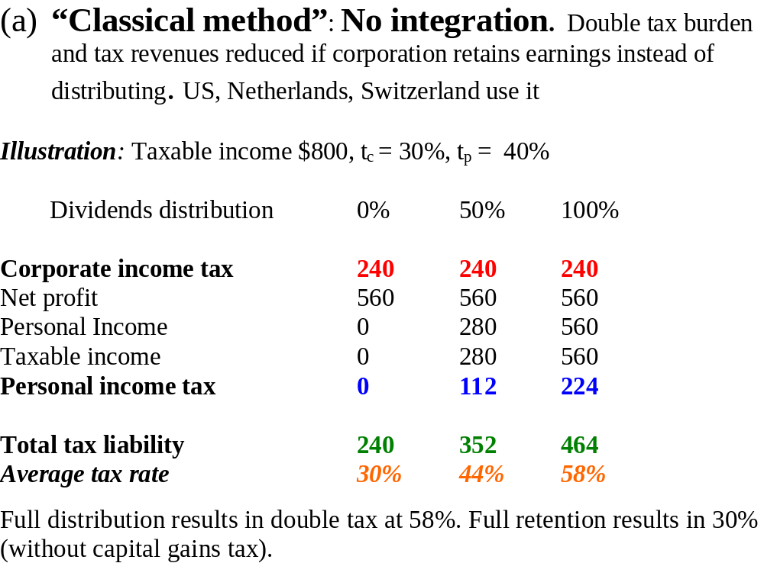
METHODS OF INTEGRATION

Slide 47
Dividend deduction or split rate system
(b) Dividend deduction system or split rate system (integration adjustment at corporate level): (Used by Austria, Japan and Portugal)
Part of corporate income that is distributed as dividends is taxed at a lower rate than the part that is retained, but dividends are also taxed at individual level.
Instead of a lower tax rate on distributed profits, a full or partial deduction of dividends distributed can be allowed which gives the same effect.
Illustration: Tax rate on corporate income that is distributed is 20% while tax rate on retention is 30%. Taxable income is again $800 and personal income tax rate is 40%.

Slide 48
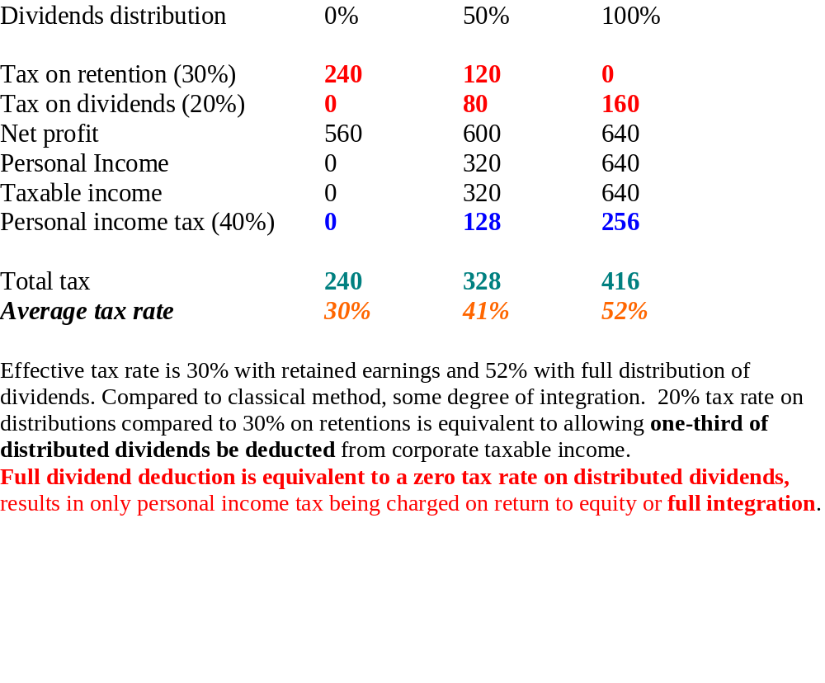
Illustration of Dividend Deduction or Split Rate System

Slide 49
Dividend tax credit or imputation system
(c) Dividend tax credit or imputation system (integration adjustment at personal level – method 1)
Dividends taxed at personal income tax rate and retention at corporate income tax rate. (Used by Australia, Finland, France, Germany, Italy, New Zealand, UK).
The entire corporate income is taxed at company level, but that part attributable to tax on dividends is credited back as tax credit at personal level. Hence, sometimes referred to as dividend tax credit or imputation system. Dividends at personal level are grossed up by factor of (1/(1-tc)) to estimate the before tax income at the corporate level, the personal tax rate is then applied, and then a credit is given for the corporate taxes estimated to have been paid at the corporate level (tc/(1-tc)*dividends distributed).
This system is referred to as an “imputed” gross up and tax credit system as it uses estimated corporate taxes paid rather than actual taxes paid. In fact, corporate taxes may be lower than estimated due to investment incentives. (Example: Canada)

Slide 50
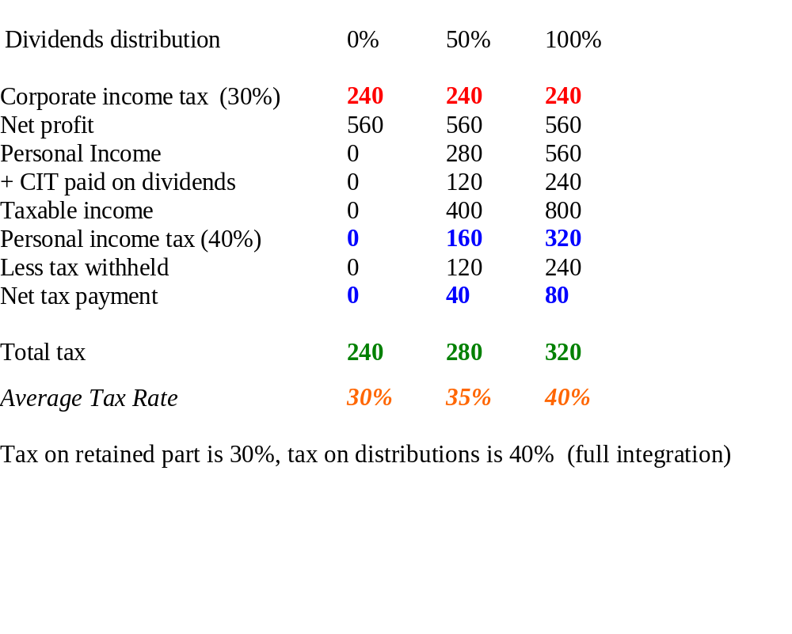
Dividend tax credit or imputation system

Slide 51
Single stage system
(d) Single stage system:
Only taxes the return to equity at the corporate level. Dividends are not included in income at the personal level. A final withholding tax may be charged on dividend payments to residents and non-residents. Commonly used in low-income countries to simplify administration where corporate ownership is concentrated in the hands of high-income individuals who typically have income levels in top marginal tax bracket. Corporate tax rate is set equal to top personal marginal tax rate bracket.
This system has a core problem (similar to imputed gross-up and dividend tax credit system and dividend deduction against PI). It assumes that profitable corporations pay tax -- that tax incentives and tax accounting conventions do not lead to excessive tax avoidance such that companies running persistent tax losses are also distributing tax-free dividends.
Effective tax is corporate tax plus any withholding tax on distributed dividends.

Slide 52
Full Integration
(f) Full integration: Tax on business profits is withheld by the full amount (like PAYE) and claimed as a credit when personal income tax is calculated. Shareholders have to declare, as personal income, their share of corporate profit, whether or not this profit was distributed. Also called "gross up method".
Alternatively, no corporate tax is charged. Corporate profits are reported as taxable income by shareholders. In the US, which generally applied classical system and now dividend deduction at personal level, offers full integration to S-Corporations, which are small corporations with a limited number of individual shareholders and no inter-corporate holdings that pay no tax at the corporate level, and more recently to limited liability companies (LLC) and limited liability partnerships (LLP). Corporate income (or losses), deductions and credits are shared out across the shareholders (or members of LLC or LLP) and declared for tax purposes in the hands of the shareholders as if it was a limited liability partnership.
Full integration is only administratively feasible for closely held businesses with relatively few resident shareholders and no inter-corporate shareholding, otherwise unmanageable problem of tracing inter-company transactions and payment to large number of shareholders.

Slide 53
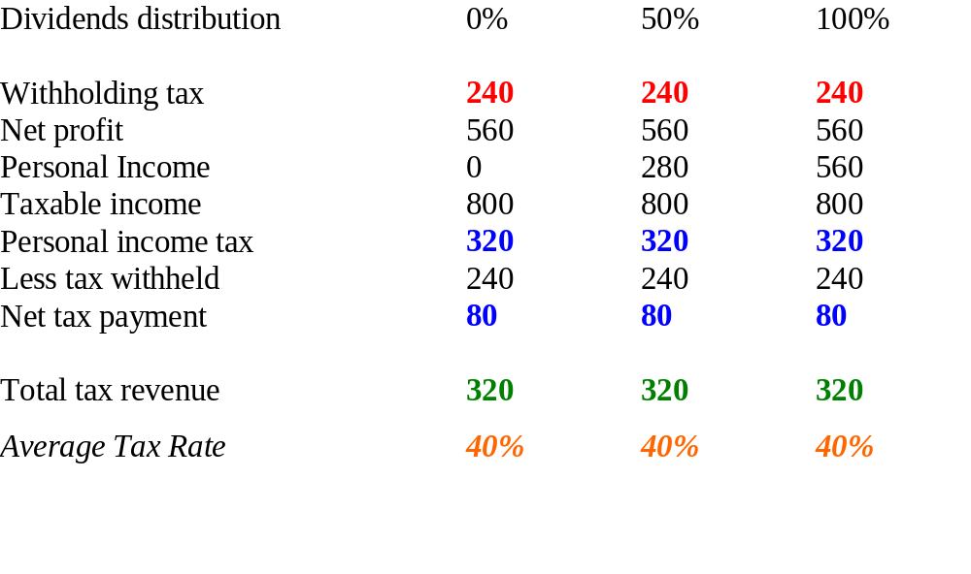
Illustrating full integration

